Slide 1
Adipocyte Auto-Labeler
Skyler Heininger, 03/15/2025

Slide 2
1. Download

Slide 3

Python Download
The plugin uses a model that requires newer code and packages than ImageJ supports.
Download python 3.12.9 from here: Python Release Python 3.12.9 | Python.org
To verify download and your computer recognizes it, open the command prompt application and type “python --version”
  This should print the python version, meaning you can run/use python! Feel free to close command prompt, we will not be needing this any longer.
  If Python is not recognized, you will need to consult online resources: You will likely have to set the PATH variable in your computers system (on Windows)

Slide 4
Download files from GitHub
Download and unzip the imagej_adipocyte_labeler.zip. This contains all the necessary source code files for the tool.
  SkylerHeininger/imagej_adipocyte_labeler
  This does not contain the model, which is too large to be stored de-compressed on GitHub. Reach out to me at skyler.heininger@uvm.edu and I can send the model and the zip file through the UVM file transfer system.

Slide 5
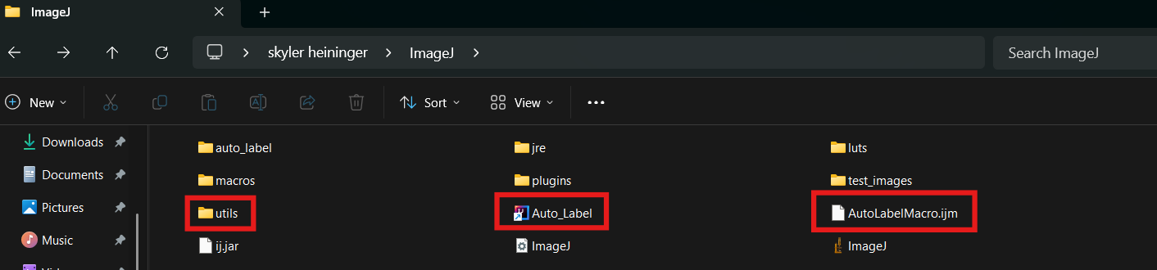
Moving files
Move all files to your ImageJ folder.
  The utils folder must be in the same folder as the ImageJ executable.
  The Auto_Label.java and AutoLabelMacro.ijm files can be anywhere you prefer, just remember where you keep them.

Slide 6
2. Installation

Slide 7
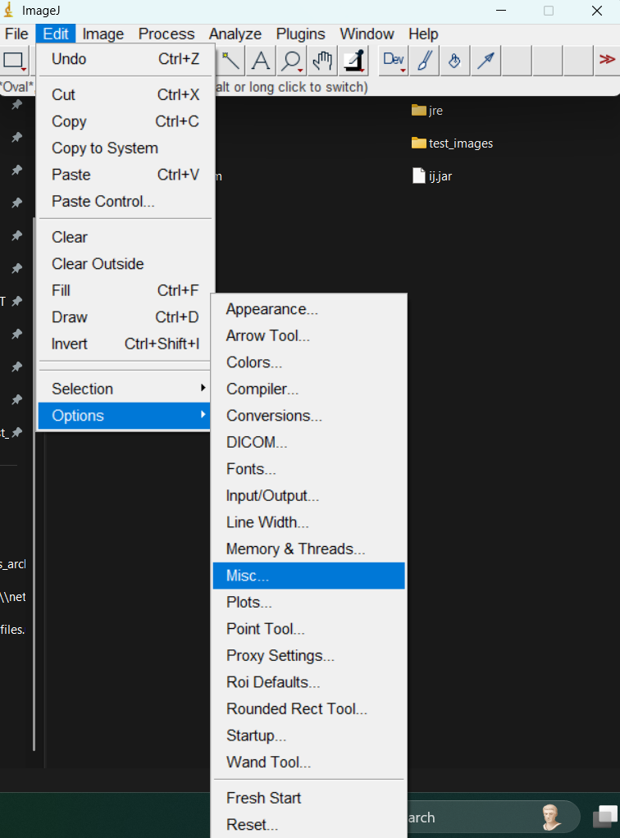
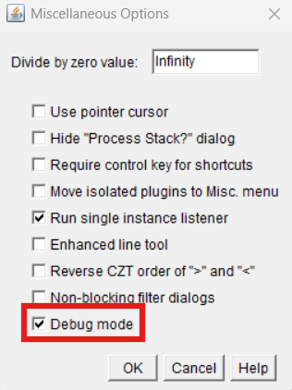
Preparing for Installation
Open ImageJ and enable debug mode
  Debug mode is found through Edit>Options>Misc…>Debug Mode
  This allows us to see what the plugin is doing.
If you ever close the log window that pops up, you will have to re-open it if you would like to see what the script is doing. After installation is complete and the tool works, this is optional.

Slide 8
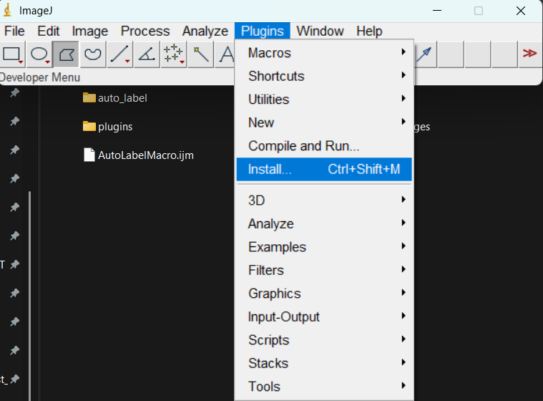
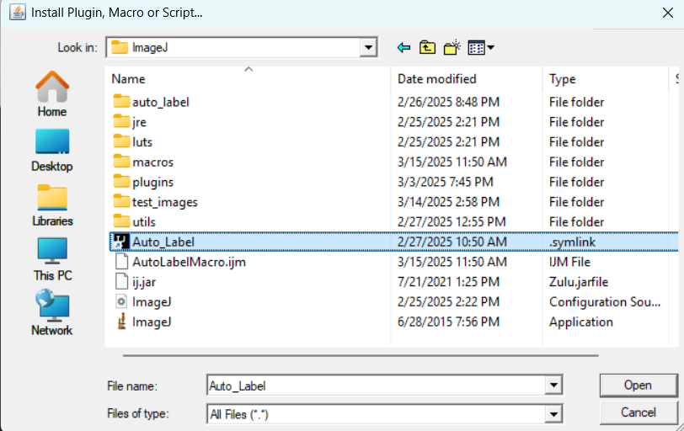
Installing Plugin
Navigate to Plugins>Install
Then select the Auto_Label.java file

Slide 9
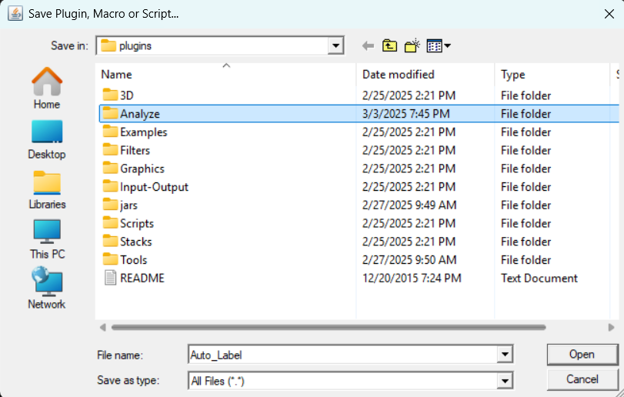
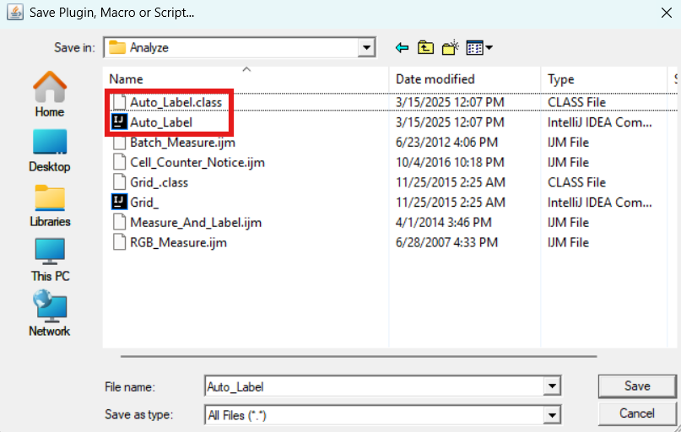
Installing Plugin, Part 2
Choose where to install the plugin. This can be wherever you like in the “plugins” folder and sub-folders.
  For instance, if you put it in “Analyze” the plugin will show up there in the menu. Once you have saved it, it will show up as Auto_Label.class and Auto_Label.java.

Slide 10
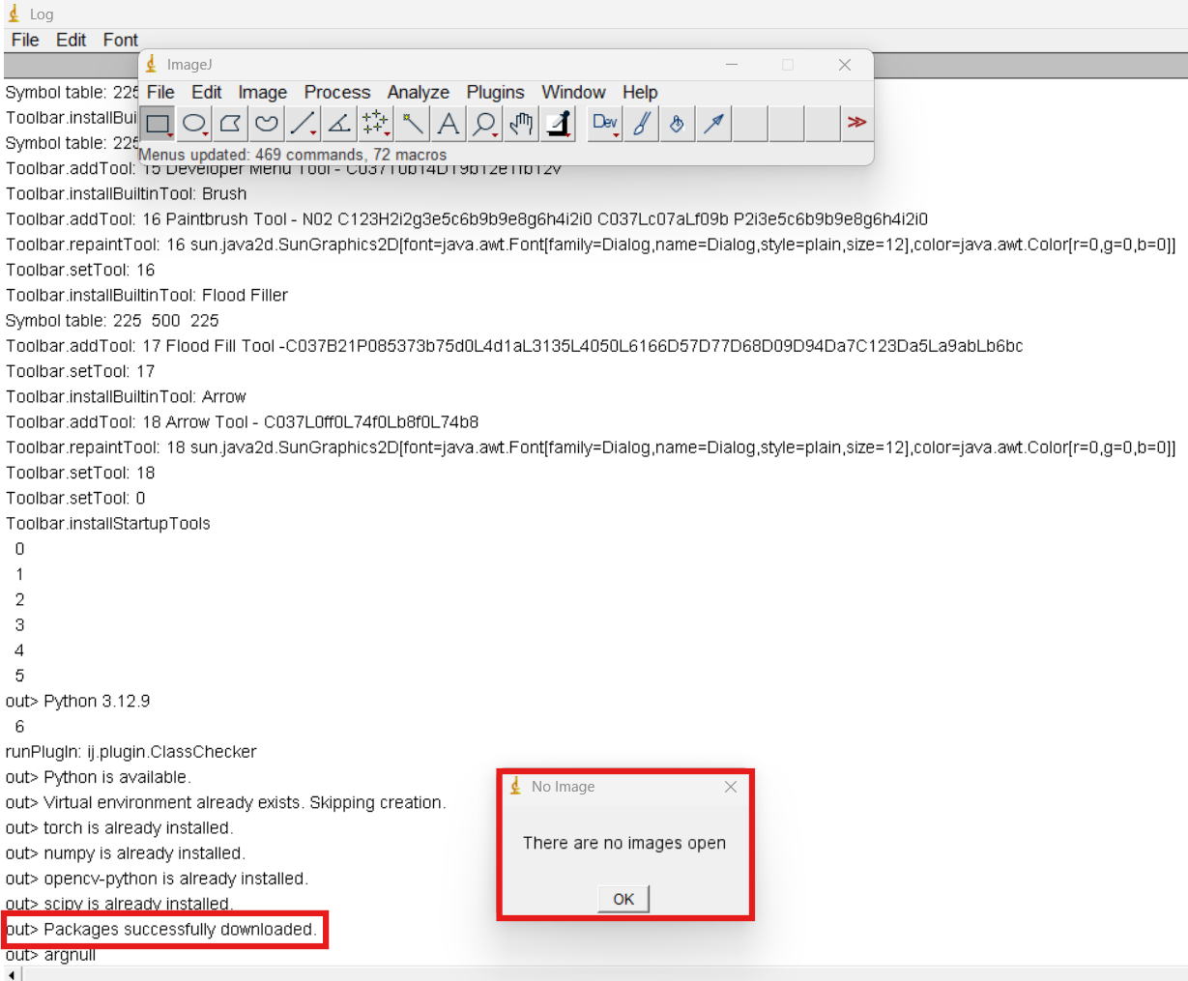
Installing Plugin, Part 3
Once you click save and installation start, the debug/log window will open, if it has not already.
This will first create a Python virtual environment and install necessary packages. This may take some time.
If all packages successfully install, a message will prompt saying all packages are installed.
  This process will take much less time in the future, as all packages are now downloaded.

Slide 11
3. Basic Usage

Slide 12
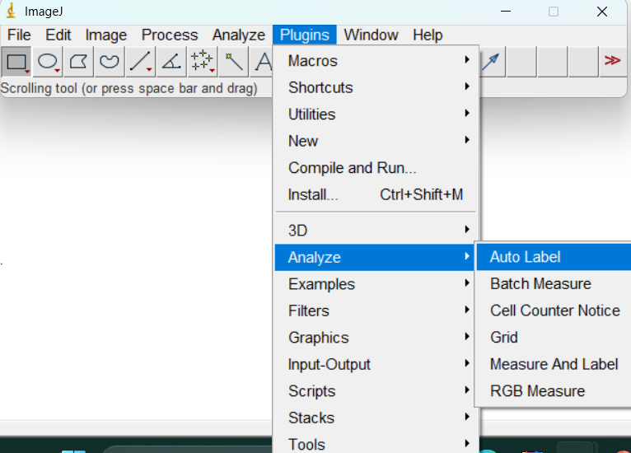
Running Plugin, Part 1
The pipeline requires pre-processed images, so run the processing macro and obtain images from that first.
Note from the last slide, a prompt popped up, saying that “There are no images open”
Now, open an image and select the plugin. It will now be located in the plugins menu, wherever you downloaded it.
  I downloaded it to analyze, so it is located under analyze for me.

Slide 13
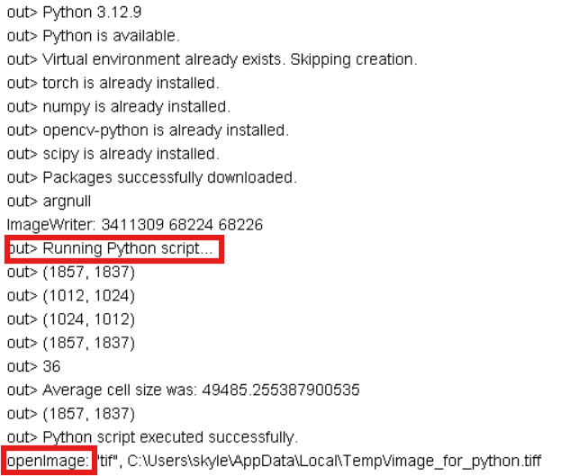
Running Plugin, Part 2
Back in the log, there will be some output, verifying the Python environment exists. This should now run near-instantly.
The output will then say “Running Python script…”
  This step will take time, especially if you have an older computer.
  This step calls the U-Net model, creates a segmentation mask, and then post-processes the output.

Slide 14
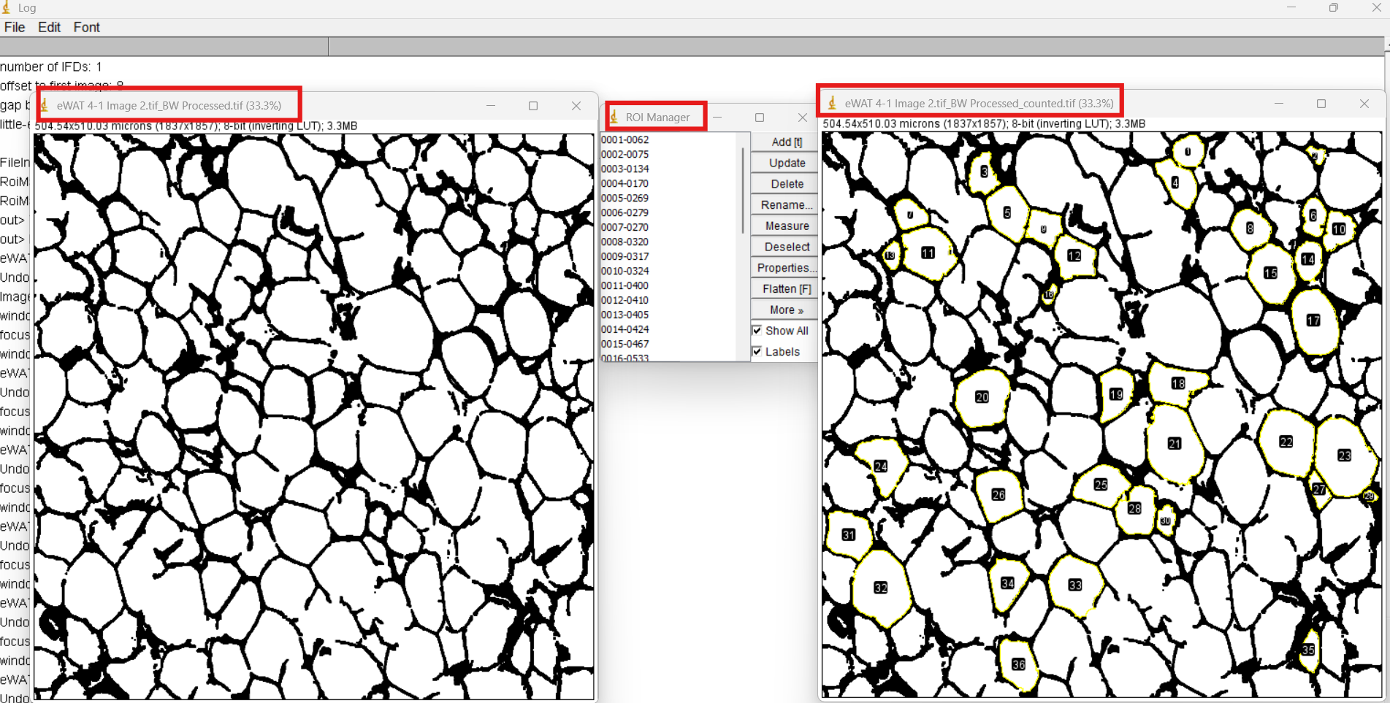
Running Plugin, Part 3
After it has completed, the script will add the ROIs to the original image, rename it, and open a copy of the original image.
  Note the names of each image.

Slide 15
Running Plugin, Summary
Running the plugin on successive images will run it on the most recently selected image.
Running the plugin on successive images will continuously concatenate ROIs to the ROI Manager.
  Take measurements and save results after each mouse (follow typical procedure).
The plugin does not alter the image, it only provides ROIs. If you delete an ROI for a cell that has a break in the membrane, you will have to close the gap with the paint brush tool before re-selecting the ROI.

Slide 16
4. Macro Usage

Slide 17
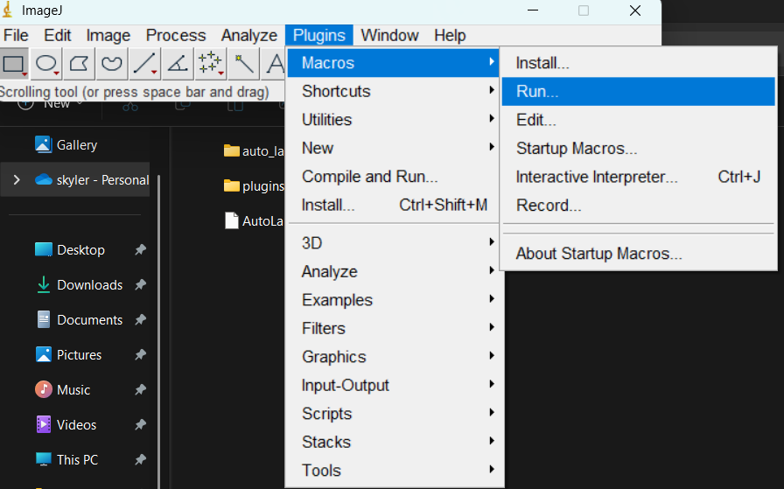
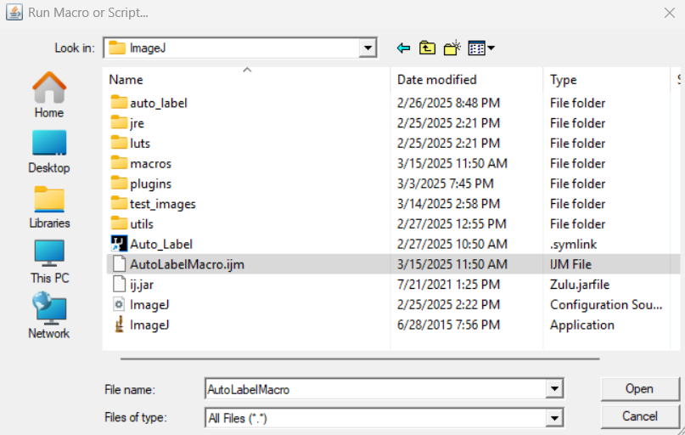
Macro Usage, Part 1
The macro simply runs the plugin on a folder of images. It uses the Plugin’s code.
Macro usage is quite streamlined. Go to Plugins>Macros>Run…
Navigate to where the AutoLabelMacro.ijm file is located

Slide 18
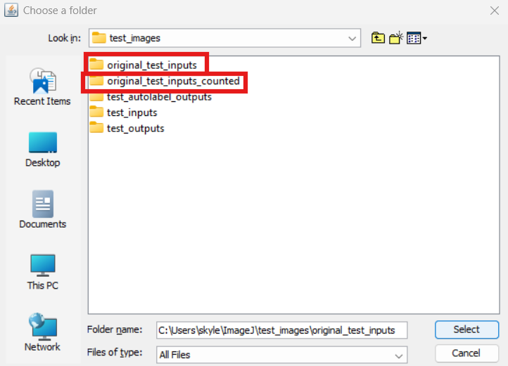
Macro Usage, Part 2
The macro will prompt you to select a folder to
run the macro on. This will use the plugin on all
files in the folder and save the labeled images
and ROIs to a folder of the same name with _counted on the end.
  Ensure all files in the folder are .tif or other form of image files.
  In the image, I had already run the macro on the original_test_inputs folder. The script automatically created original_test_inputs_counted.

Slide 19
Macro Usage, Part 3
The macro will now run the plugin on all files in the directory.
If an error occurs while running on an image, it will likely not write out the results to the output folder.
You may see the ROIManager flashing on your screen. This is because the ROIManager has to be opened in order to be used.
The macro will not open any images for you to see, or keep any images open after the fact. To double check it is running correctly, use Debug Mode (See slide 7 on preparing for installation).

Slide 20
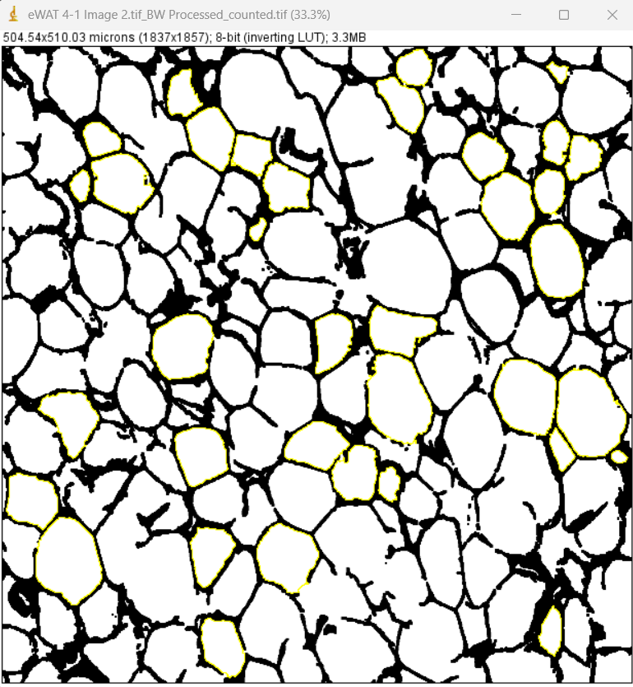
Interpreting Macro Outputs, Part 1
Once the macro has completed, the Log window should say “Batch processing complete!”
  Errors may still have occurred during running, ensure to look through the _counted directory to verify all files have been labeled.
The macro saves the image with an overlay.
This, however, is not as easy to use with the
ROIManager. You will notice that there is also
a .zip file corresponding to each labeled image.
We will use this to load all ROI’s into the
ROIManager.

Slide 21
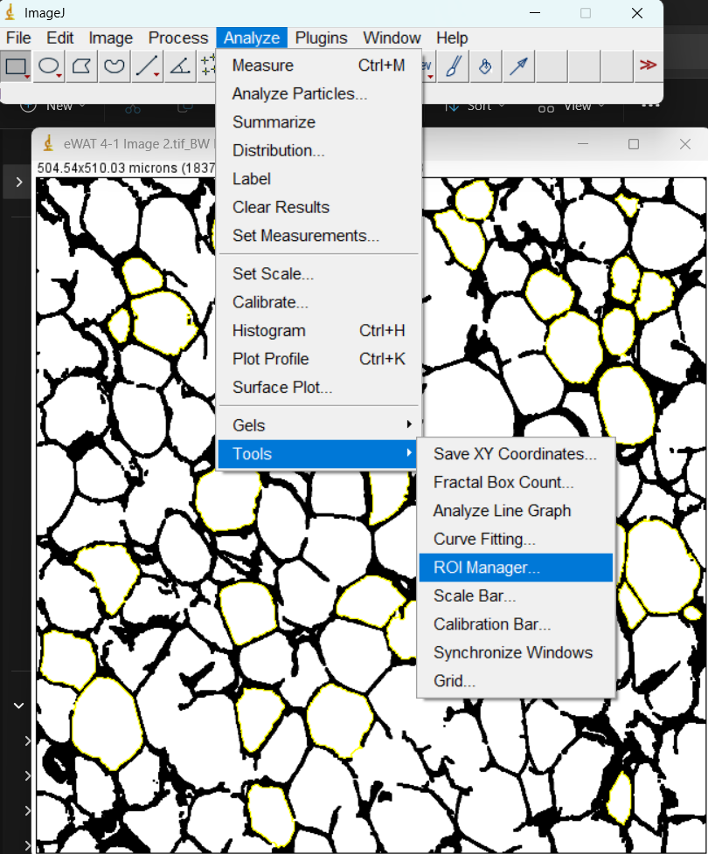
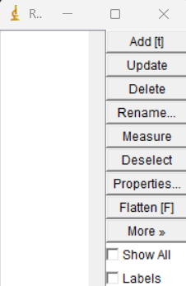
Interpreting Macro Outputs, Part 2
First, open a labeled image from the _counted directory.
Then, open the ROIManager, in Analyze>Tools>ROI Manager
  This opens a blank ROI Manager (seen below)

Slide 22
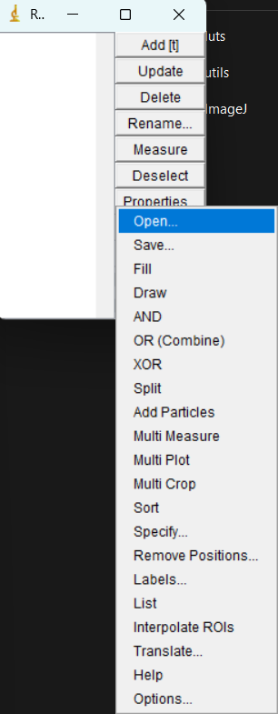
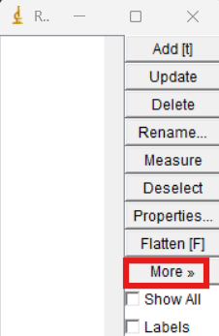
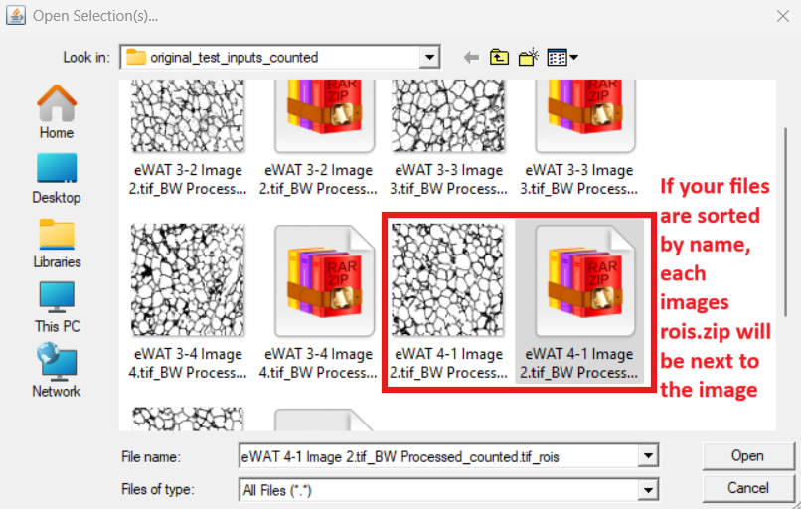
Interpreting Macro Outputs, Part 3
Now, we will load the ROIs into the ROI Manager using the .zip file corresponding to the currently opened image.
Navigate to More>Open in the ROI Manager (right side)
Then open the rois.zip file corresponding to
the image you currently have open (bottom)

Slide 23
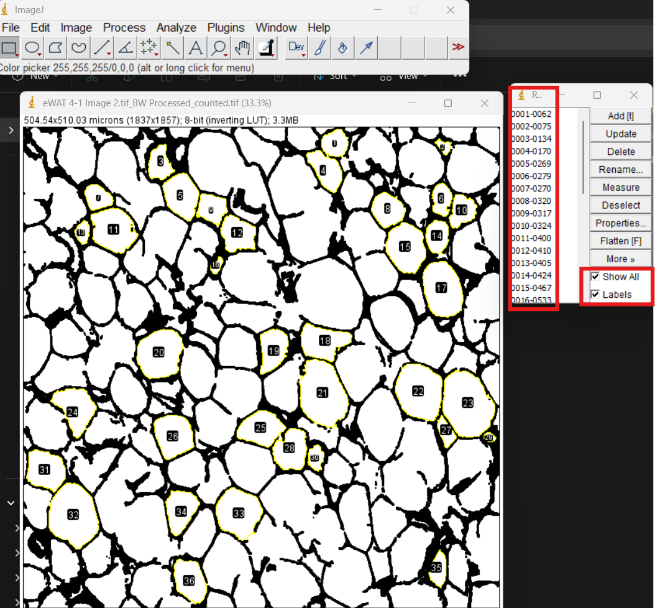
Interpreting Macro Outputs, Part 4
Once you have loaded the ROIs, the ROIs should appear in the ROIManager.
Select the boxes for “Show All” and “Labels” in the bottom right of the ROIManager.
It is recommended to only label a single image at a time using this: Importing more ROIs will overlay all ROIs on one image when selecting “Show All”.

Slide 24
5. Summary

Slide 25
Important Points
The macro uses the plugin’s code, with the slight variation of saving files rather than displaying them to the user.
  The macro saves an image with an overlay and a .zip file corresponding to each image, for use with the ROIManager.
The model/pipeline requires pre-processed images (do this using the pre-processing macro). The model/pipeline typically struggles with larger cells, so be wary of those. This tool is meant to assist with labeling and does not completely label images on its own.
  As a reminder, the pipeline does not annotate the images, it simply provides ROIs. So, if there is a break in a cell membrane, it will not change this. This is something that can be changed if wanted, where the pipeline could draw a thin black line around the perimeter of the ROI, which would close any gaps, making ROI selection and deselection slightly more streamlined.

Slide 26
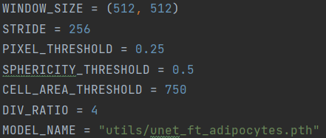
Hyperparameters
Navigate to utils/config.py. Opening this in any text editor, you can see several hyperparameters.
  Window size and stride are important for the
  model – the window size should not be
  changed under any circumstance. Stride can
  be increased or decreased if wanted, but it is recommended to leave it as it is. Reach out for more details on these
  Pixel threshold is the threshold applied to each pixel in the prediction mask. I recommend leaving this at 0.25, if not lower.
  Sphericity threshold is the minimum sphericity of cells allowed to be kept in the prediction mask. Modify this as you see fit.
  Cell area threshold is the minimum size pixel size of cells in the image. Too small and pieces of noise will be labeled as cells.
Simply edit and save config.py to change these hyperparameters.

Slide 27
Questions?
Contact me at skyler.heininger@uvm.edu with any questions, concerns, or files.

